Slide 1
Company Name: Hygienic Neem Brush
MOTTO: Brush our tooth with natural neem brush
Project Title: Hygienic Neem Brush
S.No | Name of the student | Year/Dept. | Email Id
1 | Rahamathulla A | 2nd yr/ECE | rahamathulla.ec23@krct.ac.in
2 | Ramanathan P | 2nd yr/ECE | ramanathan.ec23@krct.ac.in
3 | Tharun Kumar M | 2nd yr/ECE | tharunkumar.ec23@krct.ac.in

Slide 2
HYGIENIC NEEM BRUSH
RAHAMATHULLA.A- ECB23083
RAMANATHAN.P- ECB23086
THARUKUMAR.M- ECB23114

Slide 3
Problem Statement
To attain Hygienic life we should move to natural products. So, neem stick is one of most treditional to brush our teeth.
It is critical to brush over a neem stick for children that stick may wound their teeth.
Neem trees are rare in urban areas. There is an demand for neem sticks.
There is an need for ayurvedhic tooth brush which is comfortable for children and adults.

Slide 4


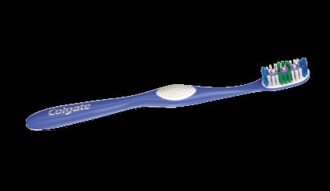
Existing Product Detail
Most predominantly every people's use either neem stick or plastic tooth brush are used to brush our teeth.

Slide 5
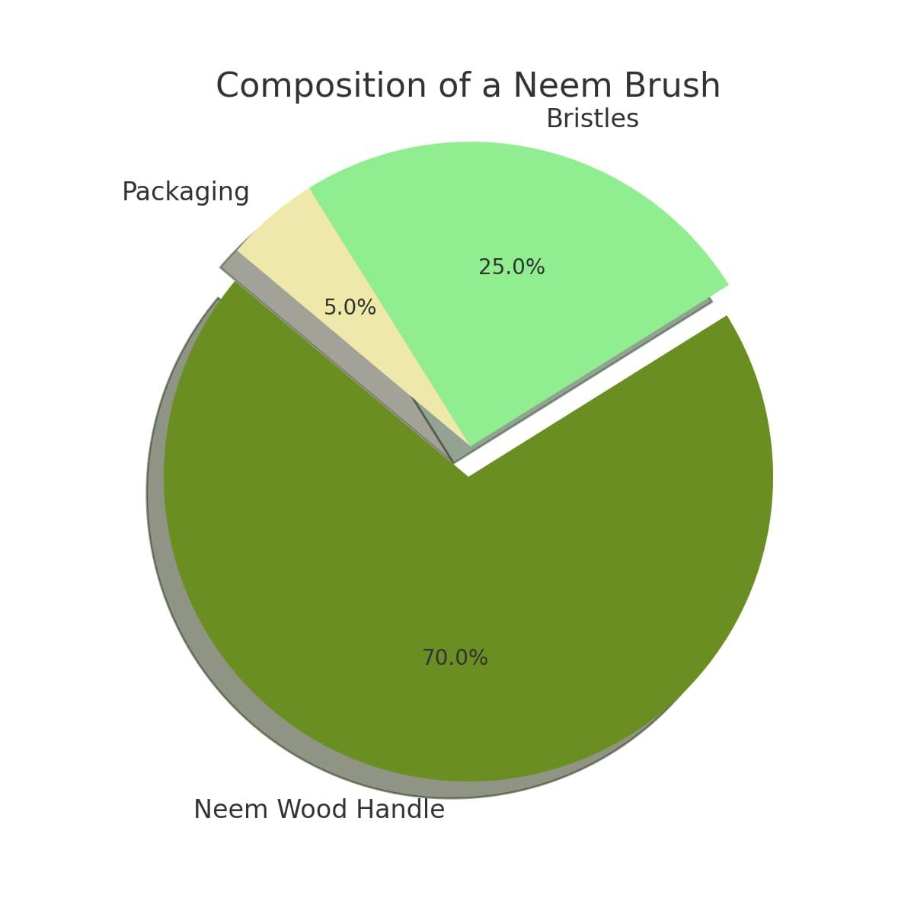
HIGHLIGHTED SURVEY REPORT

Slide 6
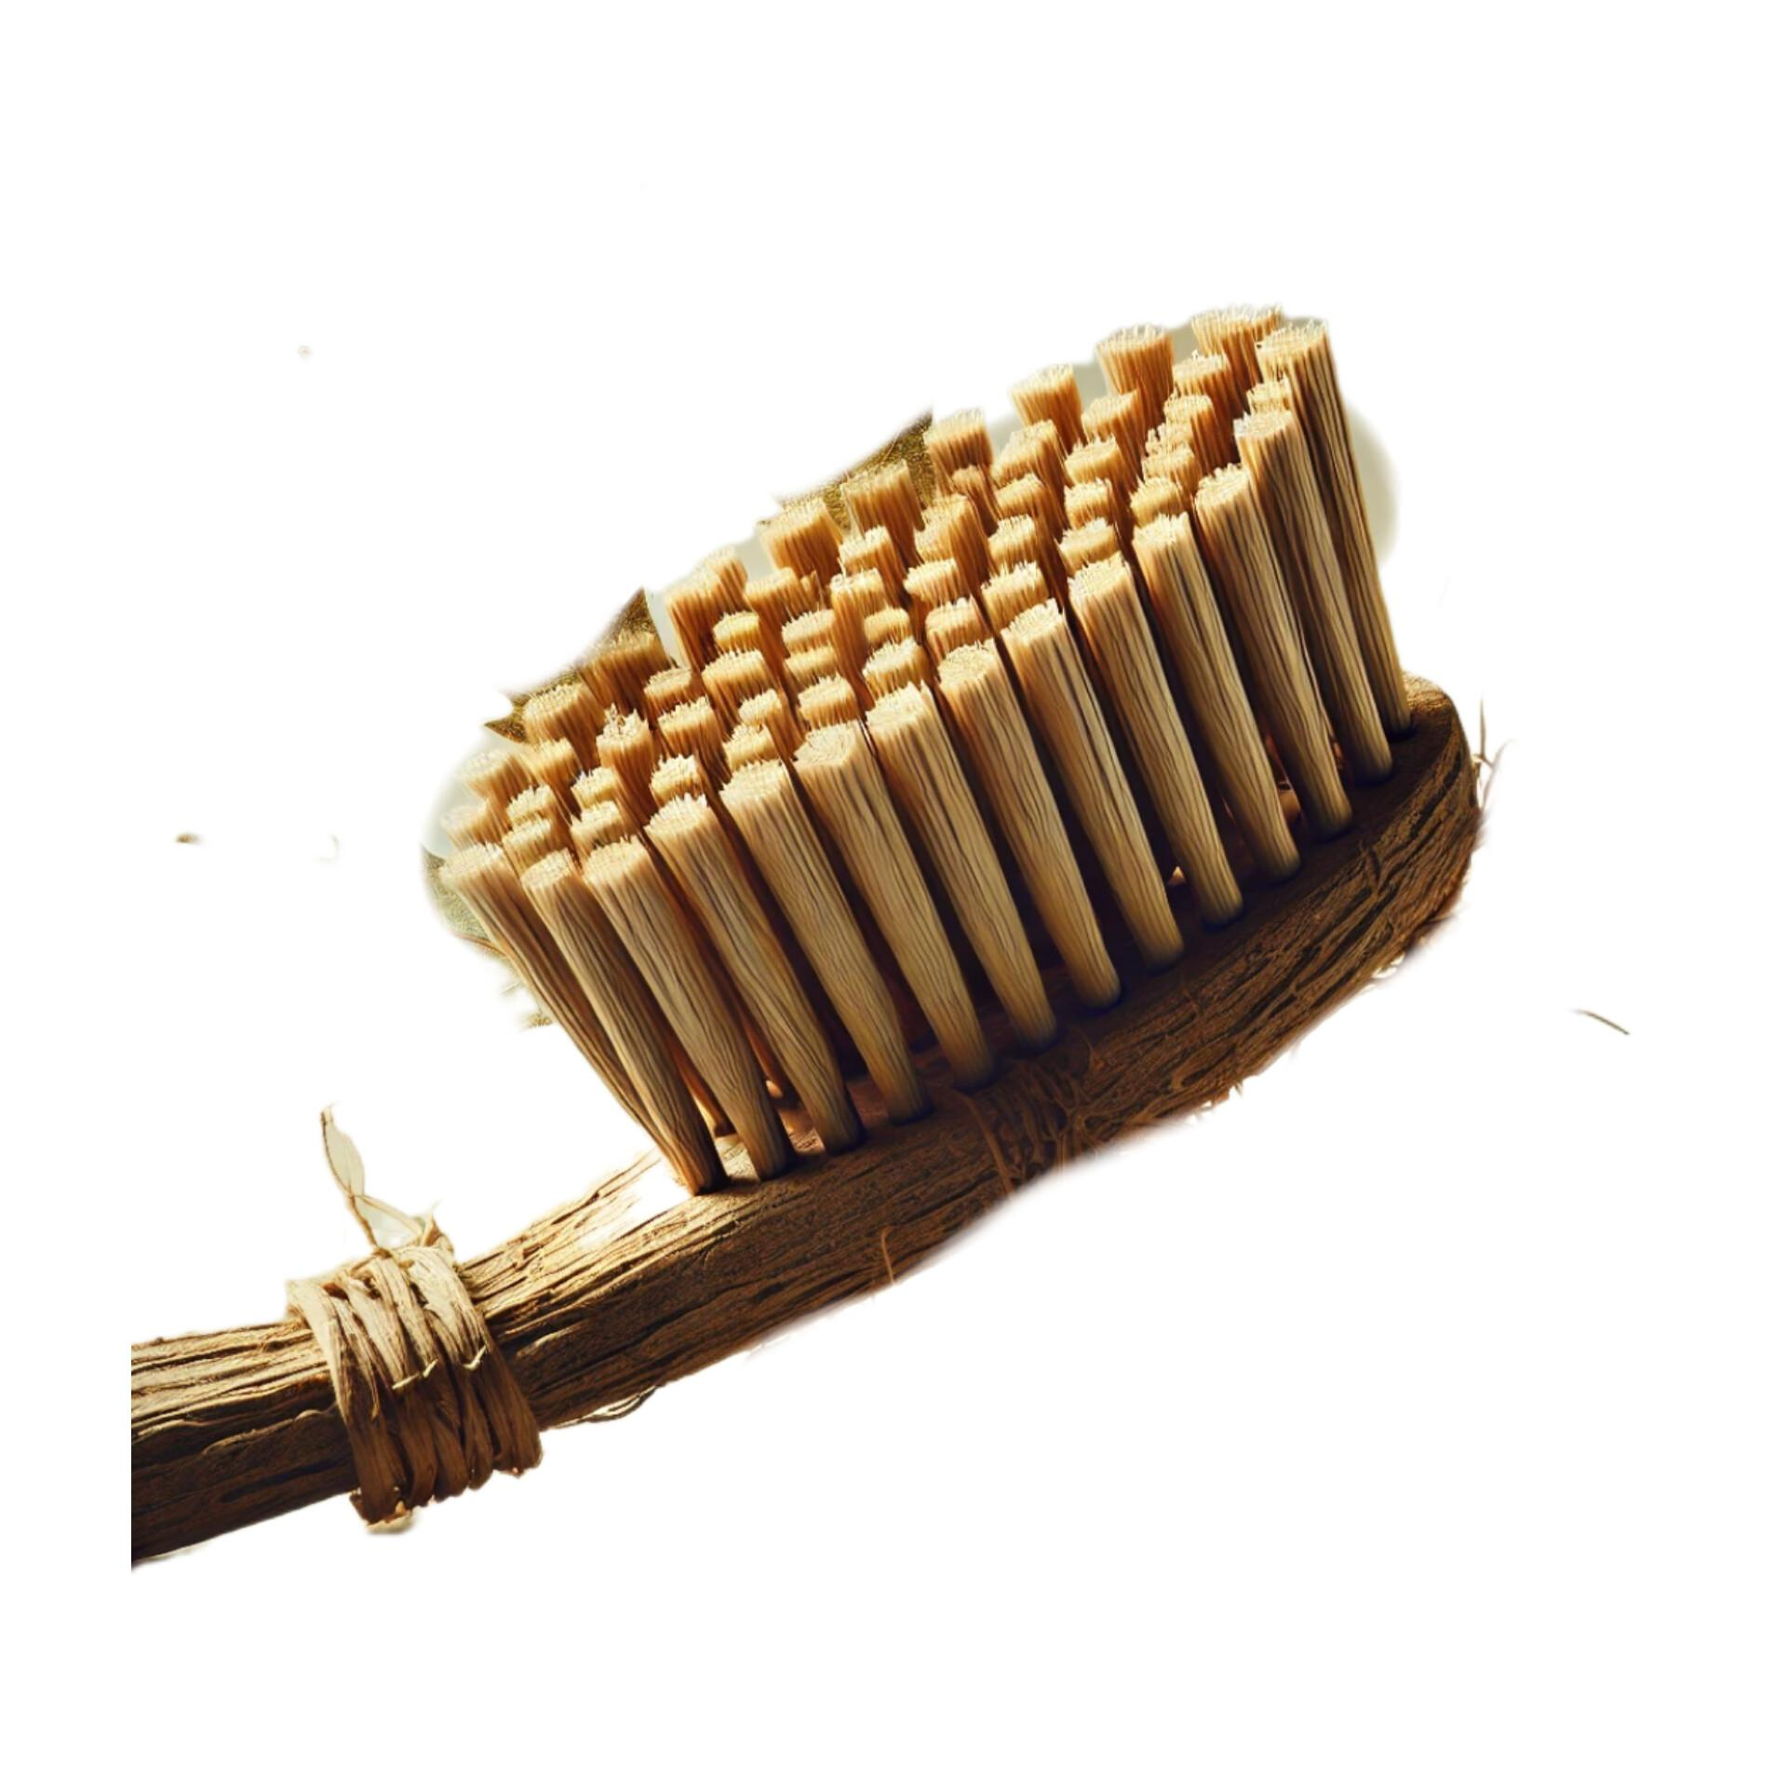
Solution (Or) Proposed Design

Slide 7
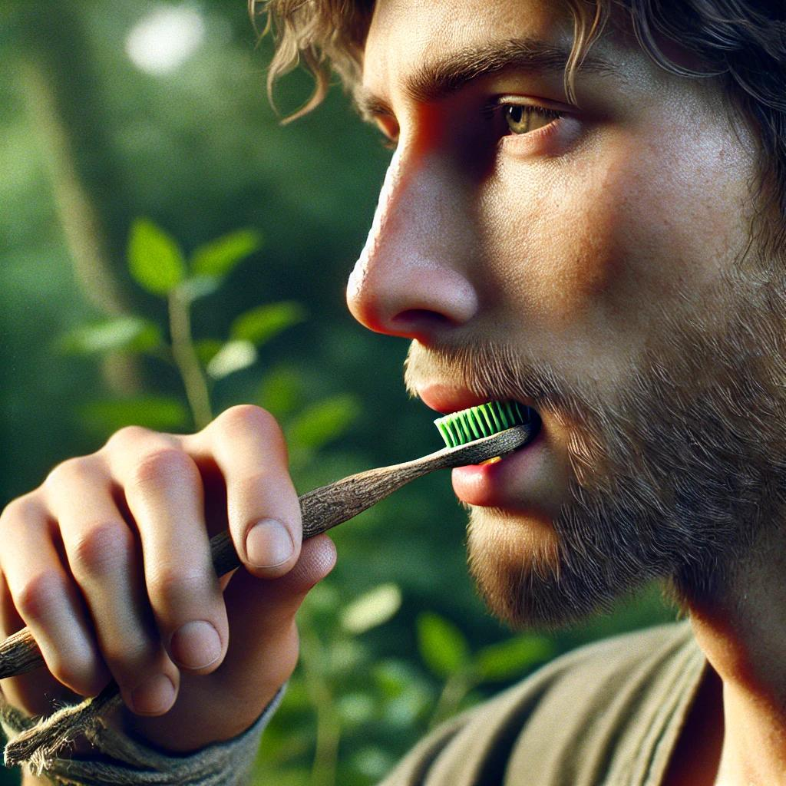
Working Of Invention

Slide 8
Target Marketing
Household Supplies Stores
Supermarkets and Grocery Stores
Ayurvedhic medical Stores
Online Marketplaces
Hospitality Industry
Home Improvement Stores
Direct Sales to Restaurants and Food Service Businesses

Slide 9
Competitor Analysis
Alternate Solutions
Usage of neem leaf powders to brush.
Usage of fresh neem sticks.
Plastic brushes are most used.
My Solution Product
Hygienic Neem Brush

Slide 10
Value Proportion
Medically Contact with Dental care.
Non-habitable for bacteria, virus, germs.
Detachable.
Easy to brush .
Ayurvedhic medicine.
Cost effective solution.

Slide 11
Channels For Marketing
E-commerce Platforms
Company Website
Social Media
Influencer Marketing
Email Marketing
Content Marketing
Online Advertising
Retail Partnerships
Customer Referral Program

Slide 12
Revenue Model
Direct Sales
Wholesale Distribution
Bundling with Other Products
Customization and Personalization
Online Advertising and Affiliate Marketing
Product Licensing and Distribution
Corporate Sales and B2B Contracts
E-commerce Marketplace

Slide 13
MARKETING STATERGY
Market Analysis
- Target Audience: Homeowners, restaurants, Ayurvedhic medicals.
- Competitor Analysis: Pricing, quality, distribution channels of competing products.
- SWOT Analysis: Strengths (medical benefits), Weaknesses (hard), Opportunities (eco- friendly options), Threats (Neem sticks).
Product Positioning
- Unique Selling Proposition (USP): eco-friendly, and efficient in antibiotic (terminate bacteria, germs,etc..
- Brand Messaging: "Effortless brushing, Lasting healthy benefits"
- Pricing Strategy: Competitive pricing with tiered options for bulk purchases.

Slide 14
THANK YOU!

